Slide 1
Azure Serverless MineReader
Richard Greene and Jack Pearson

Slide 2
“Improve Strategic Decision Making”
Large Capital Projects
e.g. mining, energy, infrastructure
Opportunity, Value & Risk (& uncertainty)
Scenario Analysis,
Portfolio Analysis
Disrupt Existing Eval methods:
Siloed
Static
Non-iterative
Single dimensional

Slide 3
Solution
Integrated. Continuous. Dynamic.
Multi-Dim. Value Chain Modelling :
Serialise resource data through VCM:
Process Model
Directed graph (nodes and flows)
Configurable expressions, accumulators
Financial Model :
dbl-entry accounting simulation
Insights
Investment, financing, strategic

Slide 4
Schematic
Strategies & Alternatives
Actionable
Insights
C-Level
Simulation Environment
Financial Model
Resource Data
Process Model
Financial Scenarios
Iterate on demand
Time
Integrated Data Repository
Version, Audit, Transform, Integrate
Install datasets

Slide 5
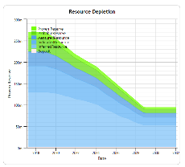
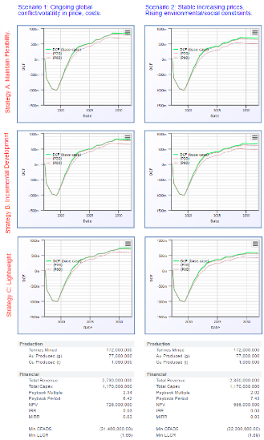
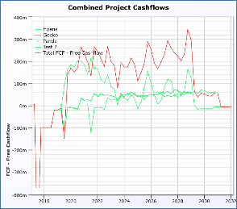
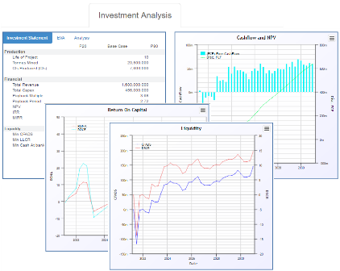
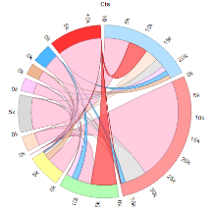
Example Outputs

Slide 6
processing requirements
1-D : 1m resource units, 25 yr model life, vcm 20 nodes: Simulation : 5 mins
Tyranny of Dimensions :
100 x alternative realities (min)
5 x design alternatives
5 x financial futures
25 x “noise”
(100 x 5 x 5 x 25) = 62,500 permutations; x 5 mins = 220 days
Target : <12 hour : distributed parallel processing

Slide 7
Round 1 - Multi-core processing on single/Multiple servers
Initial Re-Engineering :
Decompose proc. to min. atomic unit.
Dimensions
Time sequence indivisible
Data size affinity to dimensions
Job/Task management
“Un-Database-ing” at model time:
Extract bulk data
Pre-slice along certain dimensions
encrypted distributable data packets.
Serialise into binary dataset objects
Config (1,000 artifacts, 40 tables)
Serialise into binary config object.

Slide 8
Round 2 – Solving Scaling with Azure functions
Seemed like the ideal solution; can scale and the process could be broken down until small immutable tasks.
Setup of environment
Visual Studio 2015 / 2017
Visual Studio Azure Function extensions (vs2017-v15.3)
Azure Portal (in beta at the time) using a BizSpark Account
Bit Bucket for Source Control
Visual Studio Online for Continuous Integration (not fully implemented)

Slide 9










Implementation
Function
Library
4 min
Event Trigger
Sub-Result
High
Volume
Queue
Request
4 min
Final Result
C# Development
- Function
- Calculation Library
- Server Code
Main Internal Multicore
Server + Database

Slide 10
Results
100
Process
Results
What we expected
What we actually got
0
Time
But why?
Function start was heuristic based on queue length
Start up time was slow; no low level start-up control
Long process times were not a good fit!

Slide 11
Other minor issues
“Ghosting” of external DLLs
Issues with continuous deployment
Possibility of issues with in-flight execution
Deleting functions was often difficult

Slide 12

Round Three – Scaling With Batch
Zip
Azure Batch
Pull Message
Start the
pool
4 min
Sub-Result
High
Volume
Queue
Request
C# Development
- Function
- Calculation Library
- Server Code
Final Result
Main Internal Multicore
Server + Database

Slide 13
Results
100
Process
Results
What we
got!
What we expected
0
Time
Batch allowed for dependable number of nodes
Allowed for pre-built pools (high, med, low)
Central server could determine the requirements and shut down.
Not really Serverless ??

Slide 14
Lessons Learned
Know your processing requirements
Break your processing into immutable packages
Queues are ideal for this type of processing
Support is limited
Azure is a lot better now than it was, it advances FAST!
Locking on DLLs and non-ghosting of libraries
Questions ??

